Slide 1
CSE 4615:: Wireless Networks
Understanding Medium Access Control Mechanisms For Managing Shared Wireless Channels
Lecture 5
Course Teacher:
Ashraful Alam Khan
Assistant Professor, CSE, IUT
Content Contributors:
Kyle Jamieson, Princeton University

Slide 2
Today
How does channel access differ between wireless and wired networks?
Medium access control: Provisioned protocols
Contention-based medium access control

Slide 3



Wireless is a shared medium
Cathy
Wired networks:
Alice and Bob’s conversation is independent of Cathy and Eve’s conversation
Alice
Bob
Eve
Wireless networks:
Close by wireless conversations share the same wireless medium

Slide 4
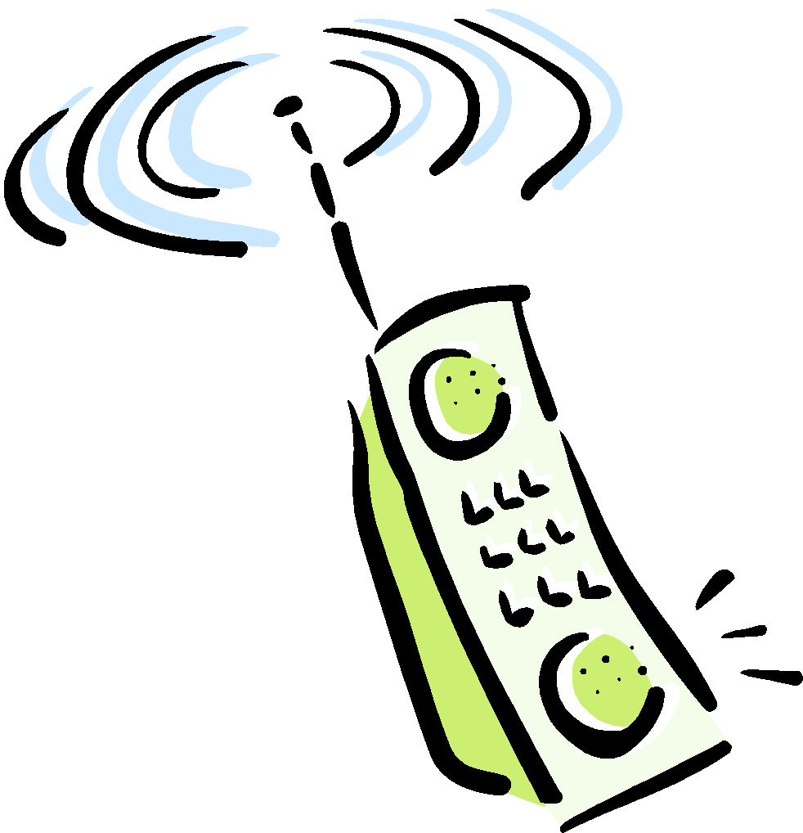

CSMA: Carrier Sense, Multiple Access
Multiple access: channel is shared medium
Station: wireless host or access point
Multiple stations may want to transmit at same time
Carrier sense: sense channel before sending
Station doesn’t send when channel is busy
To prevent collisions with ongoing transfers
But, detecting ongoing transfers isn’t always possible
A
B
C
C
A’s signal
strength
C’s signal
strength
B
A
space

Slide 5
Collision Avoidance & Collision Detection
Collision detection in wired Ethernet
Station listens (receives) while transmitting
Detects collision with other transmission
Aborts transmission and tries sending again
Problem #1 in Wireless: cannot detect all collisions
Hidden terminal problem
Fading
Problem #2 in Wireless: listening while sending
Strength of received signal is much smaller
Expensive to build hardware that detects collisions
So, 802.11 does not do collision detection

Slide 6
Channel Access through CA: Collision Avoidance, Not Detection
Listen to medium and wait until it is free (no one else is talking)
Wait a random backoff time
Advantage: Simple to implement
Disadvantage: Cannot recover from a collision

Slide 7


Wireless Interference
Two transmitting stations interfere with each other at the receiver
Receiver gets garbage
A
B
C

Slide 8
Collision Detection and CSMA-CD
Procedure
Listen to medium and wait until it is free
Start talking, but listen to see if someone else starts talking too
If collision, stop; start talking after a random backoff time
Used for hub-based Ethernet
Advantage: More efficient than basic CSMA
Disadvantage: Requires ability to detect collisions by transmitting station.
Require additional hardware antenna for concurrent receiving while transmitting (Radios are full duplex)
More difficult in wireless scenario due to significant signal attenuation

Slide 9


Collision Detection in Wired Network
Collision experienced at Receiver (node B) while both node A and C are transmitting
Here, Signal State at Receiver (node B) and Transmitter (Node A) are almost Identical.
‘Fate sharing” of the link’
A
B
C
A’s
C’s signal
strength
C’ s and
A’ s signal
strength
Covered Media
Hence, Collision Detection at Transmitter (Node A) is Feasible, by sensing(receiving) the signal strength available now by additional receiving antenna while transmission is going on.

Slide 10
Wireless Link Characteristics
Wireless is a broadcast medium!
Differences from wired link ….
decreased signal strength: radio signal attenuates as it propagates through matter (path loss)
interference from other sources: standardized wireless network frequencies (e.g., 2.4 GHz) shared by other devices (e.g., phone); devices (motors, microwaves) interfere as well
Signal Strength
space
…. make communication across (even a point to point) wireless link much more “difficult”

Slide 11
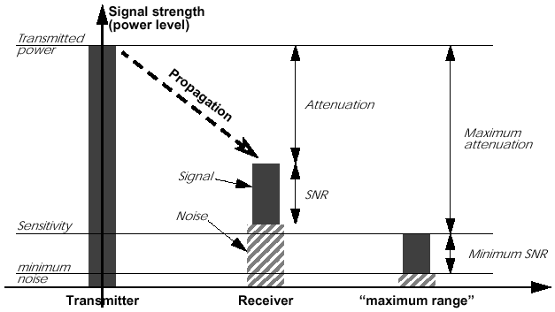
Wireless Link Characteristics: Attenuation & Propagation range

Slide 12
Collision Detection in Wireless Network
Collision experienced at Receiver (node B) while both node A and C are transmitting
Here, Signal State at Receiver (node B) and Transmitter (Node A) are NOT Identical.
‘No Fate sharing” of the link’
A
B
C
A’s
C’s signal
strength
C’ s and
A’ s signal
strength
Wireless Media
Hence, Collision Detection at Transmitter (Node A) is NOT Feasible, by sensing(receiving) the signal strength available now by additional receiving antenna while transmission is going on.

Slide 13
Failure to Detect Collision in Wireless
No “fate sharing” of the link
High loss rates
Variable channel conditions
Transmit signal is stronger than received signal
Hence, Cannot take advantage of detecting multiple transmission by simultaneously transmit and receive
Hence, Radios are not full duplex

Slide 14
Solution: Link-Layer Acknowledgments
Absence of ACK from receiver signals packet loss to sender
Sender interprets packet loss as being caused by collision
DIFS
Random
Backoff
Data Transmission
SIFS
ACK Transmission
Problem: Does not handle hidden terminal cases.

Slide 15
Carrier Sense Multiple Access with Collision Avoidance (CSMA-CA)
Similar to CSMA but control frames are exchanged instead of data packets
RTS: request to send
CTS: clear to send
DATA: actual packet
ACK: acknowledgement

Slide 16
Carrier Sense Multiple Access with Collision Avoidance (CSMA-CA)
Small control frames lessen the cost of collisions (when data is large)
RTS + CTS provide “virtual carrier sense”
protects against hidden terminal
A
B

Slide 17
Virtual Carrier Sense
Provided by RTS & CTS
Prevents hidden terminal collisions
RTS
CTS
A
B
C

Slide 18
Hidden Terminal Revisited
RTS transmission by node A, retrains all the neighbors of A from transmission during A->B transmission.
RTS transmission by node B, retrains all the neighbors of B from transmission during A->B transmission.
RTS
CTS
A
B
C

Slide 19
Understanding Medium Access: The Problem

Slide 20
Medium access: The Problem
Time 🡪
Frequency 🡪
Receiver must hear ≤1 strong transmission at a time, else collision
(transmissions are lost)
Two questions:
How should the shared medium be divided?
Who gets to use each such unit of division, and when?
A medium access control (MAC) protocol specifies the above

Slide 21
Today
How does channel access differ between wireless and wired networks?
Medium access control: Provisioned protocols
Contention-based medium access control

Slide 22
TDMA: Time Division Multiple Access
Channel time is divided into fixed-period, repeating rounds
Each user gets a fixed-length slot (packet time) in each round
Send across all frequencies during this slot
Unused slots are wasted
Out-of-band: Mechanism for allocating/de-allocating slots
e.g.: six stations, only 1, 3, and 4 have data to send
6-slot
 | round
 | 1 |  | 3 | 4 |  |  | 1 |  | 3 | 4
Time

Slide 23
FDMA: Frequency Division Multiple Access
Channel’s frequency range (for all time) divided into frequency
bands
-Each user gets a fixed frequency band (unused frequency slots are wasted)
e.g.: six stations, only #1, #3, and #4 have data to send
frequency bands 🡪
time 🡪

Slide 24
TDMA and FDMA: Considerations
Advantages
Users are guaranteed to be able to send bits, continuously (FDMA) or periodically (TDMA)
Disadvantages
Unused time slots or frequency bands reduce channel utilization
An out-of-band mechanism is needed to allocate slots or bands (which requires another channel). Slot assignment in TDMA isn’t automatic—it requires coordination over a separate signaling channel.
Guard bands or guard times reduce channel utilization

Slide 25
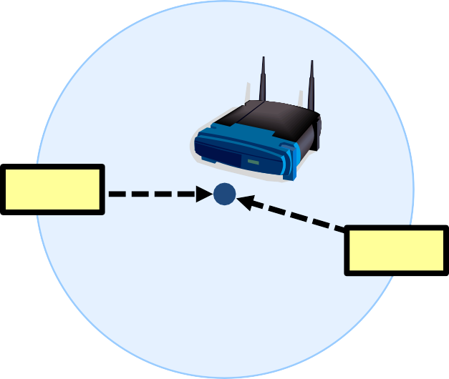
CDMA: Code Division Multiple Access
All users transmit over the same frequencies, and at the same time:
Okay!
Cathy
Alice (CDMA)
Bob
Allows multiple users to coexist and transmit simultaneously with no interference

Slide 26
Today
How does channel access differ between wireless and wired networks?
Medium access control: Provisioned protocols
Contention-based medium access control

Slide 27
Idea: Use a single, shared channel
Spread transmission across whole 100 MHz of spectrum
Remove constraints assoc. w/one channel per user
No need for strict one-channel-per-user allocations.
Users can dynamically access any part of the shared channel, making it more efficient and flexible
Robust to multi-path fading
In wireless environments, signals reflect and arrive along multiple paths
Spreading the signal across many frequencies ensures that even if some parts are lost, others may arrive intact
Supports peer-to-peer communication
Collisions: Receiver must hear ≤1 strong transmission at a time
So adopt
deference from Ethernet
– Listen (carrier sense, CS) before sending, defer to ongoing

Slide 28





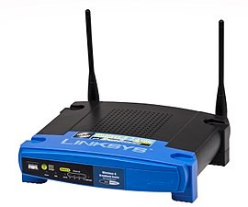

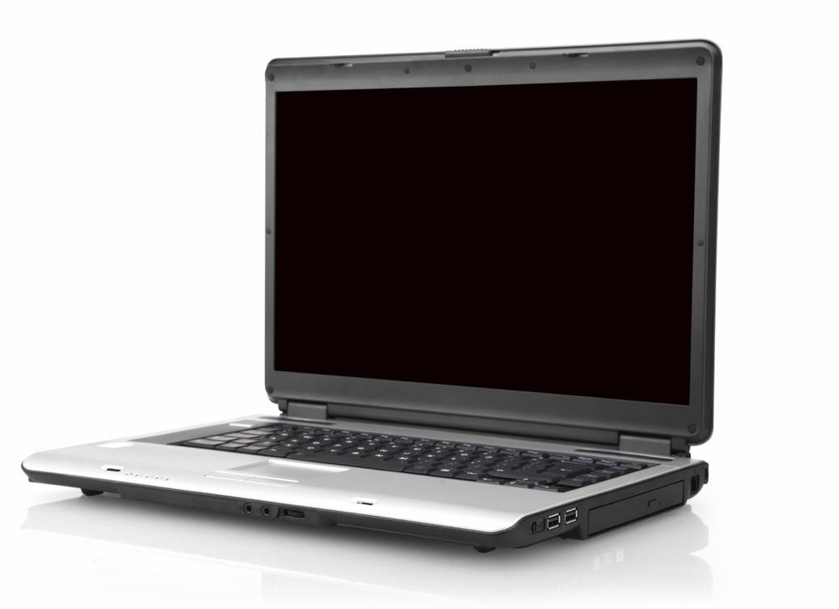
Concurrency versus Taking Turns
Far-apart links should send concurrently (spatial reuse)
Nearby links should take turns:

Slide 29


When Does CS Work Well?
Two transmission pairs are far away from each other
– Neither sender carrier-senses the other
_{A}B
_{C}D
B transmits to A, while D transmits to C.

Slide 30


When Does CS Work Well?
Both transmitters can carrier sense each other
– Carrier sense uses thresholded correlation value to determine if medium occupied
But what about cases in between these extremes?
_{A}B _{D}
C
B transmits to A, D transmits to C, taking turns.

Slide 31
Hidden Terminal Problem
A B C
C can’t hear A, so C will transmit while A transmits – Result: Collision at B
Carrier Sense insufficient to detect all transmissions on wireless networks!
Key insight: Collisions are
spatially located at receiver

Slide 32
Exposed Terminal Problem
A B C
If C transmits, does it cause a collision at A? No!
– Yet C cannot transmit while B transmits to A
Same insight: Collisions spatially located at receiver

Slide 33
RTS/CTS
Exchange of two short messages: Request to Send (RTS) and
Clear to Send (CTS)
Algorithm
A sends an RTS (tells B to prepare) with message length k
B replies an CTS (echoes message length)
A sends its Data
1. “RTS, k bits”
3. “Data” _{B}
2. “CTS, k bits”
A
C

Slide 34
Deference to CTS
Hear CTS 🡪 Defer for length of expected data
transmission time
– Solves hidden terminal problem
1. “RTS, k bits”
3. “Data” _{B}
2. “CTS, k bits”
defers
A
C

Slide 35
Deference to RTS, but not CS
Hear ->RTS ,-> ^{No} CTS ^{, ->} Data
So terminals
Do not transmit to D !
C
But Could transmit to D !
1. “RTS, k bits”
3. “Data” _{B}
2. “CTS,k bits”
A
C
D

Slide 36
Deference to RTS, but not CS
exposed
B, C
can transmit concurrently:
So terminals
1. “RTS, k bits”
3. “Data” _{B}
2. “CTS,k bits”
A
C
D
✅ Common Solutions:
1. RTS/CTS Mechanism (Request to Send / Clear to Send)
Node B sends an RTS to A.
A replies with a CTS.
Node C hears RTS from B but does not hear CTS from A (because A is out of C’s range).
➤ C knows it won’t interfere with A and can proceed with its own transmission safely.
✅ Insight: RTS/CTS provides receiver-based collision control, not just sender-based carrier sensing.

